Slide 1
COMP2225
Software Engineering
Session 9: Software Development Process – Implementation and Integration: Concepts and Practices
Dr. Adrian Als & Dr. Paul Walcott
Department of Computer Science, Mathematics and Physics
University of the West Indies, Cave Hill Campus
Barbados
NEXT

Slide 2
Session Objectives
On successful completion of this session a student will be able to:
  Discuss verification and validation activities throughout the software lifecycle
  Distinguish between program validation and verification
  Distinguish between the different types and levels of testing unit, integration, systems, and acceptance)

Slide 3
Session Objectives Cont’d
On successful completion of this session a student will be able to:
  Evaluate the quality of a document and a product
  Create, evaluate, and implement a test plan for a medium-size application.

Slide 4
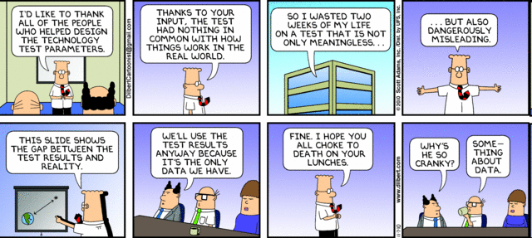

Slide 5
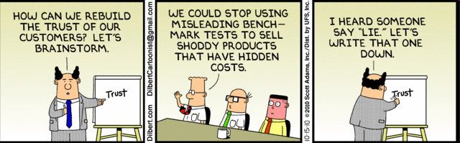

Slide 6
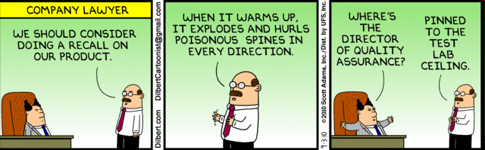

Slide 7
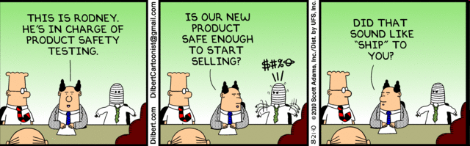

Slide 8
Implementation and Integration
Concepts and practices

Slide 9
Introduction
The design document is the input to the implementation and integration stage and the output is executable code and associated artefacts.
In this session we will examine the issues associated with this transition along with the approaches to integration, testing and debugging.

Slide 10
Implementation
Implementation is the process of translating the detailed design into code
Generally done by teams all working at the same time on different components of the product.
Notes:
Implementation is the process of translating the detailed design into code. This is generally done by teams all working at the same time on different components of the product.

Slide 11
Documentation produced
Source code (major component)
Additional documentation to assist in maintenance.
  all test cases against which the code should be tested
  the expected results
  and the actual output.
  (NB: These documents will be used in regression testing)
Notes:
The major documentation that is provided in this stage is the source code; however, the programmer should provide additional documentation to assist in maintenance. This additional documentation includes all test cases against which the code should be tested, the expected results, and the actual output. These documents will be used in regression testing.

Slide 12
Implementation Issues
Choice of programming language
The use of 4th generation languages (4GLs)
Use of good programming practices

Slide 13
Choice of programming language
In many cases, there is no opportunity for choice because either only one choice is available or management stipulates that the product should be implemented in a given language.
A cost-benefit analysis may be employed to decide on the language. The language with the largest expected gain would be the one selected.
Notes:
What are some of the costs associated with a programming language:
Purchase Price, Licensing and Training

Slide 14
Which programming language?
A risk analysis may also be used to aid in the selection of the language. The language with the smallest overall risk is selected.

Slide 15
The use of 4th generation languages (4GLs)
The ease of programming
The program is shorter, quicker to develop and easier to maintain
Potential productivity gain
Notes:
4th Generation languages are non-procedural. That is they express what is to be done rather than the details of how it is actually carried out. For example – Take me to town v.s. turn left at the university exit then follow the Spring Garden Highway until you reach the traffic lights. Keep straight at the traffic lights… etc… etc… etc…
Goal of 4Gl’s -> Uses fewer statements to achieve the same functionality.
In decreasing order of number of statements required to achieve same functionality:
1st Gen -> Machine Language (ML)
2nd Gen -> Assembly Language
3rd Gen -> Natural Language (1 statement = 5 – 10 ML statements) (C++, COBOL and Ada)
4th Gen -> 1 statement = 30 – 50 ML statements. E.g. Oracle, PowerBuilder and SQL

Slide 16
Use of good programming practices
Best practices:
  the use of consistent and meaningful variable names
  provision of proper documentation; both prologue and inline comments
  use of parameters (as opposed to constants)
  well formatted source code to increase readability
  structured programming (i.e. modular programming)
Notes:
Regardless of the language of choice, it is recommended that the programmers employ good techniques when implementing their code. Such techniques include:
the use of consistent and meaningful variable names
provision of proper documentation; both prologue (e.g. This program will….) and inline comments
use of parameters (as opposed to constants)
well formatted source code to increase readability; good use of blanks and indentation to highlight control structures.
Structured programming (i.e. modular programming) is also advised to improve code quality, maintainability and decrease the effort required for testing.
Consider the case where a project has both an Israeli (Hebrew) and a Mozambique (Portuguese) implementation team. This would be a case where good programming practices would be crucial and also the use of a common language.

Slide 17
Integration
Integration is the process of combining the modules (or subsystems) and determining whether the product as a whole functions correctly.
Notes:
Integration
Integration is the process of combining the modules (or subsystems) and determining whether the product as a whole functions correctly.

Slide 18
Integration Issues
Factors that may affect the quality of the resulting product include:
  whether the modules are integrated all at once or one at a time
  the specific integration order, i.e. top-to-bottom in the module interconnection diagram or bottom-to-top.
Notes:
Issues under consideration during this phase that may affect the quality of the resulting product include:
a. whether the modules are integrates all at once or one at a time
b. the specific integration order, i.e. top-to-bottom in the module interconnection diagram or bottom-to-top. Note that if a bottom-up approach is used and there is a major design fault (higher up) then it will show up late, necessitating an expensive rewrite. Conversely, if the modules are integrated top-down then the lower-level modules would receive comparatively less through testing than the other scenario.

Slide 19
‘implementation and integration’
The four approaches are:
  separate implementation and integration phases
  top-down implementation and integration
  bottom-up implementation and integration
  sandwich implementation and integration.

Slide 20
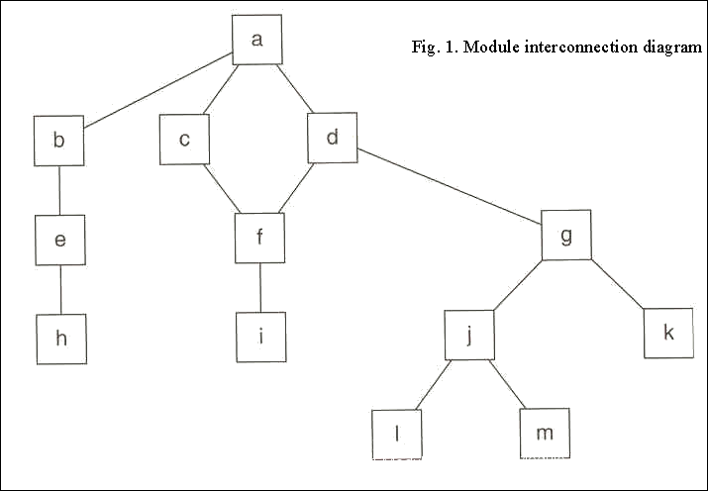
Module Interconnection Diagram
Notes:
SEE MSWORD DOOCUMENT FOR NOTES ON THE DIFFERENT APPROACES
Sandwiched approach: Combined both top-down and bottom-up approaches
Separate modules into logical (calling) and operational (called) categories.
The logical modules are implemented and integrated using a top down approach
The operational modules are implemented and integrates using a bottom up approach.

Slide 21
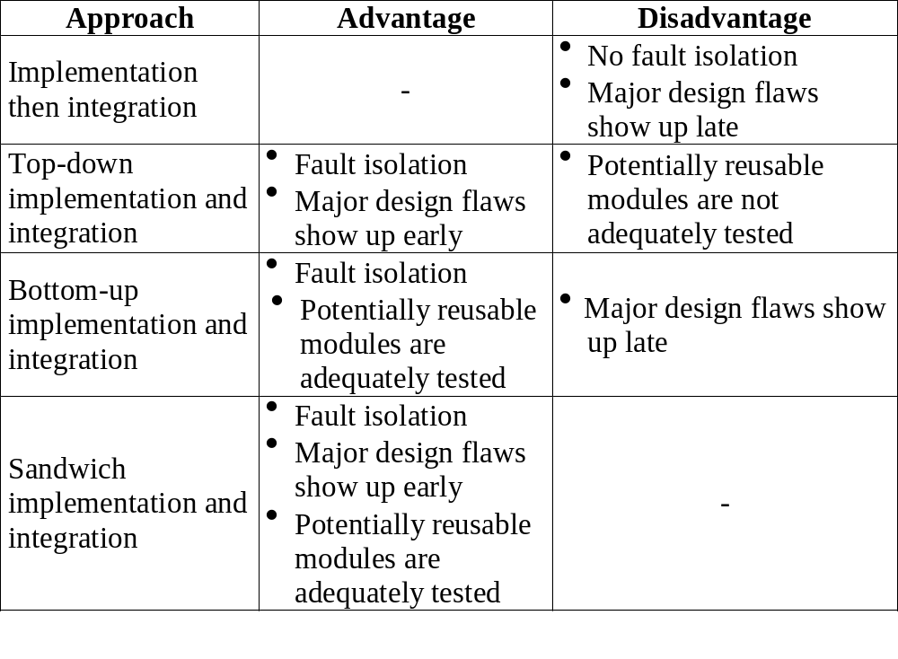
Approach Comparisons

Slide 22
Testing
Important to guarantee quality of software
Must be part of entire software process
Also known as Verification & Validation (V&V)
Cannot guarantee the absence of all defects in the final product
Notes:
Ideally testing should be done throughout the entire software process and not as an afterthought at the end of a phase. Worst of all is should not be delayed until just prior to the deliver of the final product to the client.

Slide 23
V&V
Verification asks the question “Are we building the product right ?”
  How much does the product conform to its specification?
Validation asks the question “Are we building the right product ?”
  How satisfied is the client with the product?
Notes:
The goal of testing is to ensure software quality. Testing is also known as verification and validation.
Verification refers to the process of determining whether a phase has been correctly carried out; this takes place at the end of each phase. Validation is the intensive evaluation process that takes place just before the product is delivered to the client. Its objective as a whole is to determine whether the product as a whole meets its specifications.
Verification asks the question “Are we building the product right?” while validation asks the question “Are we building the right product?”. The first term emphasises adherence to the specifications, the second with satisfying the customer. To accomplish the desired ends both static (non-execution based) and dynamic (execution based) methods are employed
non-execution = verification
execution based = validation
building it right" checks that the specifications are correctly implemented by the system.
Quality Control – Verification
Quality Assurance – Validation

Slide 24
SQA Groups
Special teams called Software Quality Assurance groups may be set up
SQA groups are composed of independent specialists
SQA groups seek to monitor and advance the testing aims of the developer
Notes:
SQA teams should be independent specialists who have managerial independence from the development teams. A more senior manager (over the manager of the SQA and the manager of the development teams) should be decide what to do when there is a difference of opinion between what the SQA team wants and what the development team wants. For example the SQA team may decide that delivery of a product should be delayed while more testing is done while the development team may be confident and ready to deliver the current product to the client, and wishing to move on the other projects.
What is quality? – The extent to which a piece of software meets it specifications.

Slide 25
Testing Categories
Non-Execution Based
Execution Based
Notes:
Two categories of testing may be outlined -:
a) Non-execution based testing (Verification)
b) Execution based testing (Validation)

Slide 26
Non-Execution Based Testing
Applies to the documentation trail
Done by groups of reviewers
Not to be confused with program testing

Slide 27
NEB Testing – Walkthrough I
Walkthrough – carried out by a team of representatives from various groups in the software process and chaired by a member of the SQA (Software Quality Assurance) group
Documents reviewed
No original authors involved
Notes:
This type of testing involves the reviewing of documents by several persons who are not the original authors. One type of review is called the walkthrough.
Walkthrough: a review is carried out by a small team including representatives from the specifications team, client, next team in the process and the manager of the specifications team. A person from the SQA group should chair the walkthrough team.
Any faults uncovered are flagged to be later fixed by competent members of the team to whom this task falls. The walkthrough committee is not competent to actually fix any faults found.
The walkthrough process is done over a period no longer than two hours at a time. No member of a walkthrough committee should be evaluated by any other member in the committee as this will tend to divert from the finding of faults.
Another type of review is called the inspection.
Inspection : Inspection is a more rigorous procedure where a checklist of potential faults are drawn up and carefully checked to see if they are present or not in the documents.

Slide 28
NEB Testing – Walkthrough II
Each member involved in the walkthrough committee should be independent of the other members
Individual review sessions should last no longer than 2 hours
Walkthrough committee only flags errors but cannot fix them

Slide 29
NEB Testing – Inspection I
The goal of the inspection process is the detection, logging and correction of defects.
The product document is checked against its sources, and the rules that govern its production.
Inspections provide a mechanism for improving the process which produced the given inspected program document
Notes:
The product document is checked against the requirements and rules (e.g. no ambiguities, contradictions etc…) are applied.
Analogy: For an English document, rules may state that
All sentences must start with a capital letter and end in the appropriate punctuation mark. If it is a question a “?” must be used and it is a regular sentence a period must be used.
From bullet points 2 and 3 we note that the product and process are tested and improved.

Slide 30
NEB Testing – Inspection II
Checklists of potential faults are drawn up then documents carefully checked to see if these faults are present
Rigorous procedure which can detect many flaws in product
Will increase costs early in the software process
Do further research on inspections online on the course website. ☺
Notes:
Essentially NEB testing occurs in the initial developmental phases (REQ -> Design)
Next we will discuss EB testing, which starts from the implementation phase.

Slide 31
Execution Based Testing I
Product is executed using test data
Success depends on choice of test data
Limitations of testing all possible cases
Notes:
Execution based testing (validation) has been defined as
“a process of inferring certain behavioural properties of a product based, in part, on the results of executing the product in a known environment with selected inputs” – Goodenough, 1979

Slide 32
Execution Based Testing II
Execution based testing (validation) has been defined as
“a process of inferring certain behavioural properties of a product based, in part, on the results of executing the product in a known environment with selected inputs” – Goodenough, 1979

Slide 33
Properties I
Utility – given a correct product and permitted conditions, how much are the users’ needs met.
Reliability – How often does a product fail and how damaging are the effects of the failure?
Notes:
Some of these behavioural properties include:

Slide 34
Properties II
Robustness – How does the product respond when given a range of valid/invalid inputs.
Performance – Does the product meet its constraints in terms of time & memory space. E.g. embedded systems may be only allowed a small amount of memory overhead.
Correctness – Does the product satisfy the output specifications, all else being equal.

Slide 35
Five Stages of Program Testing
Unit
Module
Subsystem
System
Acceptance

Slide 36
Program Testing I
Unit Testing - individual components are tested independently of other system components.
Module Testing - A module consists of several units which work together and are interdependent. The goal is to ensure that all the components in the particular module function correctly with respect to each other
Notes:
1st bullet: each component may be a function and the testing is performed by a programmer
2nd bullet: E.g. A Financial Module may contain the following functions: Sales, Tax, Invoices and Revenue

Slide 37
Program Testing II
Subsystem - Several modules which must be integrated into a subsystem are tested together. Interface problems may be encountered.
System - The previously tested subsystems are now combined into the system. Any incorrect interactions are detected and noted. Correction may require changes to the subsystem and subsequent re-testing.
Notes:
1st bullet: E.g.Editor, Database and Finance planning
2nd bullet: Combining each of the three above subsystems would then form an accounting system.

Slide 38
Program Testing III
Acceptance Testing: During this final stage (before product handed over to client) the system is tested using “real world” data supplied by the client rather than the simulated test data used by the developer.

Slide 39
Alpha & Beta Testing
Alpha Testing – Developer and client must agree. Used with custom (bespoke) software.
Beta Testing – Trial versions of software sent to potential buyers. Problems reported used to correct defects. Used with generic software.
Notes:
In the case of tailor made systems, the acceptance testing continues until both developer and client agree that the system has reached an acceptable stage with regard to the system requirements. The acceptance testing in this case is referred to as alpha testing.
In the case where the system is generic and to be marketed to customers beta testing is used. During beta testing a pool of potential customers agree to use the system. The problems they experience are then reported back to the developers. This real world use of the product normally shows up many unanticipated defects in the product.
The feedback allows changes to be made and either a new beta released or the product released. Typically after each iteration of a beta release the number of reported problems plummets until the product has met the required standard.

Slide 40
Testing Strategies
Top Down
Bottom Up
Notes:
A system can be conceptualised as a tree structure in which the parts of the system are children to the root node. A subsystem will have a number of children indicating modules which will in turn have child nodes indicating procedures or functions. Using this view we can take one of the following strategies

Slide 41
Top Down Testing
Testing starts with the most abstract component (root node & immediate children) then proceeds towards the more detailed ones

Slide 42
Bottom Up Testing
Converse to top down
More detailed components tested first then modules at the higher (more abstract) levels

Slide 43
Challenges to Top Down & Bottom UP
In the case of top down detailed components may not yet exist; these may have to be simulated
In the case of bottom up the difficulty may be to simulate the environment the eventual system will create; other subsystems not yet in existence may have to be simulated

Slide 44
Correctness Proofs
This is the strategy where testing is handled by mathematically proving the product is correct
Costs may be significant to adopt this approach but may be worth it in safety critical systems
This technique should not be used by itself
Notes:
Testing would still need to be done to ensure that the product is implemented corrected.

Slide 45
Black-Box Testing (behavioural testing)
Examines some fundamental aspect of the system with little regard for the internal logical structure of the software.
Conducted at the software interface
Notes:
Black-box testing attempts to find errors in the categories:
1. Incorrect or missing functions
2. Interface errors
3. Errors in data structures
4. Behaviour or performance errors
5. Initialisation and termination errors

Slide 46
Black-Box Testing Cont’d
Used to demonstrate that:
  software functions are operational
  input is correctly accepted
  output is correctly produced
  the integrity of external information (e.g. a database) is maintained
Notes:
Black-box testing attempts to find errors in the categories:
1. Incorrect or missing functions
2. Interface errors
3. Errors in data structures
4. Behaviour or performance errors
5. Initialisation and termination errors

Slide 47
Black-Box Testing Cont’d
Test are designed to answer to following questions:
  How is functional validity tested?
  How is system behaviour and performance tested?
  What classes of input will make good test cases?
  Is the system particularly sensitive to certain input values?
Notes:
Black-box testing is applied during the latter stages of testing (unlike white-box testing).
It purposely disregards control structure and attention is focused on the information domain
The ultimate goal of BB-testing would be to look at every possible combination and value of input. Is this practical?

Slide 48
Black-Box Testing Cont’d
Test are designed to answer to following questions:
  How are the boundaries of a data class isolated?
  What data rates and data volume can the system tolerate?
  What effect will specific combinations of data have on system operation?
Notes:
Black-box testing is applied during the latter stages of testing (unlike white-box testing).
It purposely disregards control structure and attention is focused on the information domain
The ultimate goal of BB-testing would be to look at every possible combination and value of input. Is this practical?

Slide 49
White-box Testing (Glass testing)
White-box testing of software is based on close examination of procedural detail
Logical paths through the software are tested
The “status of the program” may be examined at various points to determine if the expected or asserted status corresponds to the actual status
Notes:
Looking inside the (black) box.
White-box testing, sometimes called glass box testing, is a test case design method that uses the control structure of the procedural design to derive test cases.

Slide 50
White-box Testing II
Using white-box testing methods, the software engineer can derive test cases that:
  Guarantee that all independent paths within a module have been exercised at least once.
  Execute all logical decisions on their true and false sides
  Execute all loops at their boundaries and within their operational bounds
  Exercise internal data structures to assure their validity.
Notes:
White box testing occurs earlier in the testing phases.
The ultimate goal of WB-testing would be to test every execution path in the program logic. Is this practical?

Slide 51
Why White-Box testing?
We often believe that a logical path is not likely to be executed when, in fact it may be executed on a regular basis.
Typographical errors are random
Logic errors and incorrect assumptions are inversely proportional to the probability that a program path will be executed
Notes:
Logic errors and incorrect assumptions are inversely proportional to the probability that a program path will be executed.
We often believe that a logical path is not likely to be executed when, in fact it may be executed on a regular basis. The logical flow of a program is sometimes counter intuitive, meaning that our unconscious assumptions about flow of control and data may lead us to make design errors that are only uncovered once path testing commences
Typographical errors are random. When a program is translated into programming language source code, it is likely that some typing errors will occur. Many will be uncovered by syntax and type checking mechanisms, but others may go undetected until testing begins. It is as likely that a typo will exists on an obscure logical path in as on a main stream path.

Slide 52
Debugging I
Objective: To find and correct the cause of a software error.
Debugging occurs as a result of successful testing.
Is an art that depends on experience and some degree of ‘luck’.
Some people have the skill to do it naturally
Notes:
Debugging occurs as a result of successful testing. When a test case uncovers an error, debugging is the process that results in the removal of the error. A software programmer, evaluating the results of a test, is often confronted with a symptomatic indication of a software problem. Sometimes there is no obvious relationship between the external manifestation of the error and its internal cause. Consequently, debugging is often described as an art.
E.G. Like a doctor => a cough by itself could mean anything. However a cough and other specific systems, A, B and/or C could imply X, Y or Z.
Experience – not incrementing counters would be an easy debugging problem for an experienced debugger

Slide 53
Why is debugging so difficult?
The symptom may be caused by human error(s) that are not easily traced.
The symptom may be because of timing problems rather that processing errors
It may be difficult to accurately reproduce input conditions (e.g. real-time application in which the input order is indeterminate).
Notes:
Care has to be taken that in fixing errors that more errors are inadvertently introduced. This is particularly true in cases where there is an lot or pressure on the software developer to correct existing errors.
Timing problems are usually associated with real time applications.

Slide 54
Why is debugging so difficult? Cont’d
The symptom may disappear (temporarily) when another error is corrected.
The symptom may be caused by non-errors (e.g. round-off inaccuracies)
Notes:
Care has to be taken that in fixing errors that more errors are inadvertently introduced. This is particularly true in cases where there is an lot or pressure on the software developer to correct existing errors.
Timing problems are usually associated with real time applications.

Slide 55
The Debugging Process and Approach
Execution of test cases
Test cases
Results
Regression tests
Additional tests
Suspected causes
Debugging Approaches
Brute force
Back tracking
Cause elimination
Corrections
Debugging
Identified causes
Debugging Process

Slide 56
Brute Force
This is the most common approach and also the least effective method for isolating the cause of a software error.
This method is usually applied when all else fails.
This approach often leads to wasted effort and time
Produce as much information in hope that the error can be isolated
Notes:
This is the most common approach and also the least effective method for isolating the cause of a software error. This method is usually applied when all else fails. In this approach Run-time traces, and/or the program is loaded with write statements and/or memory dumps are used with the hope that a clue to the cause of the error may be found in the large amount of information collected. This approach often leads to wasted effort and time. If used a lot of thought should be expended first.

Slide 57
Backtracking
This is a fairly common approach that is especially successful in small programs.
Beginning at the site where a symptom has been uncovered, the source code is traced backwards manually until the cause is found.
Unfortunately as the number of lines increases, the number of potential backward paths may become unmanageably large.

Slide 58
Cause Elimination
Uses induction or deduction:
  Data related to the error occurrence are organised to isolate potential causes
  A cause hypothesis is devised and the above data are used to prove or disprove the hypothesis
Alternatively:
  a list of all the possible causes is developed and tests are conducted to eliminate each
Notes:
. If initial tests indicate that a particular cause hypothesis shows promise, data are refined in an attempt to isolate the bug.

Slide 59
Use the Quiz for a Quick Recap
Do you want a quick recap? Why not use the quiz?
  Use either the immediate feedback version
    Provides a correct or incorrect message response after each question
  Or, the non-immediate feedback version

Slide 60
The input to the implementation and integration phase is the design document and the major output is source code.
Implementation & Integration Quiz
Question 1
A
True
B
False
Peek
Click Peek to lookup the answer in the notes.
Skip

Slide 61
The testing strategy in the implementation stage is execution based.
Implementation & Integration Quiz
Question 2
A
True
B
False
Peek
Click Peek to lookup the answer in the notes.
Skip

Slide 62
The class of testing that involves using real world testing data from the clients is referred to as
Implementation & Integration Quiz
Question 3
A
Unit testing
B
System Testing
C
Acceptance Testing
D
None of the above
Peek
Click Peek to lookup the answer in the notes.
Skip

Slide 63
______________ testing examines some fundamental aspect of the system with little regard for the internal logical structure of the software.
Implementation & Integration Quiz
Question 4
Click on _____________ to enter answer.
Peek
Click Peek to lookup the answer in the notes.
Skip

Slide 64
The best implementation and integration approach to use is:
Implementation & Integration Quiz
Question 5
A
Separate implementation and integration
B
Top-down implementation and integration
C
Sandwich implementation and integration
D
Bottom-up implementation and integration
Peek
Click Peek to lookup the answer in the notes.
Skip

Slide 65
Congratulations
You have successfully completed the quiz
Click here to see your report card

Slide 66
Reflective Question
What is the best programming language to employ when implementing an application ?

Slide 67
Conclusions
In this session the reader was able to :
  discuss verification and validation activities throughout the software lifecycle.
  distinguish between program validation and verification.
  distinguish between the different types and levels of testing (unit, integration, systems, and acceptance)

Slide 68
Conclusions
In this session the reader was able to :
  undertake, as part of a group activity, an inspection of application.
  create, evaluate, and implement a test plan for a medium-size application.

Slide 69
References
Sommerville, Ian. 2004. Software Engineering. 7th ed. USA: Addison Wesley

